Slide 1
Java I/O

Slide 2



Streams
An I/O Stream represents an input source or an output destination. A stream can represent many different kinds of sources and destinations, including disk files, devices, other programs, and memory arrays.
Streams give us a consistent mechanism for reading or writing data, independent of where the data is physically.
Streams support many different kinds of data, including simple bytes, primitive data types, localized characters, and objects.
Remote file
write
My Application
Streams
Local file
read
Console

Slide 3
Introduction to I/O
In Java, streams are the sequence of data that are read from the source and written to the destination.
An input stream is used to read data from the source. And, an output stream is used to write data to the destination.
class HelloWorld {
public static void main(String[] args) {
System.out.println("Hello, World!");
}
}
For example, in our first Hello World example, we have used System.out to print a string. Here, the System.out is a type of output stream.
Similarly, there are input streams to take input.

Slide 4
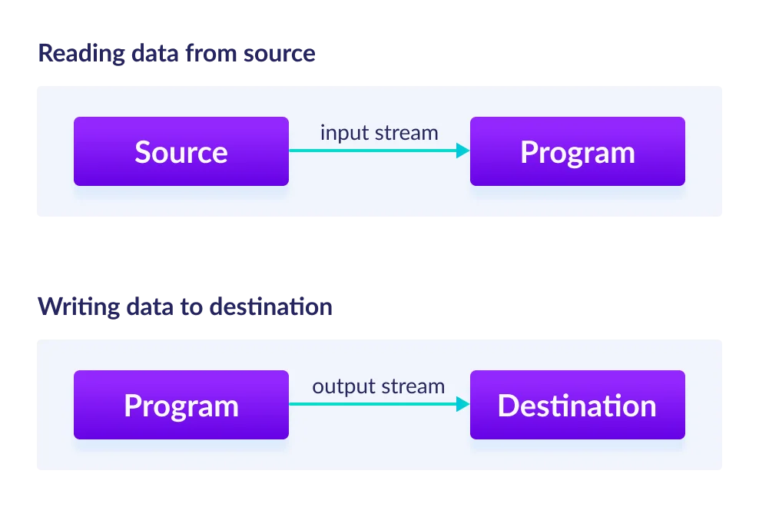
Introduction to I/O
We have input streams and output streams

Slide 5
Types of Streams
Depending upon the data a stream holds, it can be classified into:
Byte Stream
Byte stream is used to read and write a single byte (8 bits) of data.
All byte stream classes are derived from base abstract classes called InputStream and OutputStream.
Character Stream
Character stream is used to read and write a single character of data.
All the character stream classes are derived from base abstract classes Reader and Writer.

Slide 6
I vs O
There exist two basic classes of stream: input (I) and output (O)...
My Application
read
InputStream
read
Remote file
write
OutputStream
write
Local file

Slide 7
InputStream and OutputStream
These are the most low level classes in the Java I/O framework (java.io)
InputStream reads bytes from a stream
int read() returns the next byte or -1 if there are no more
OutputStream writes bytes to a stream
void write(int b) writes the byte to the stream
Both have some other functions for working with arrays of bytes

Slide 8
File streams
FileInputStream extends InputStream to allow bytes to be read from a file
FileOutputStream extends OutputStream to allow bytes to be written to a file

Slide 9
Example as input.txt
Java features:
Simple:Java was designed to be easy for the professional programmer to learn and use effectively.
Object Oriented Programming Language: Java everything is an Object.
Architectural neutral. A central issue for the Java designers was that of code longevity and portability.
Multithreaded; java allows you to write programs that do many things simultaneously.
Robust,The multi platform environment of the web places extraordinary demand on the program, because the program must execute reliably in a variety of systems.
Distributed;Java is designed for the distributed environment of the Internet because it handles TCP/IP protocols
Dynamic,small fragments of bytecode may be dynamically updated on a running system.

Slide 10
Byte Streams
Programs use byte streams to perform input and output of 8-bit bytes. All byte stream classes are descended from InputStream and OutputStream.
There are many byte stream classes. To demonstrate how byte streams work, we'll focus on the file I/O byte streams, FileInputStream and FileOutputStream. Other kinds of byte streams are used in much the same way; they differ mainly in the way they are constructed.
Using Byte Streams
We'll explore FileInputStream and FileOutputStream by examining an example program named Program, which uses byte streams to copy input.txt, one byte at a time.

Slide 11
CopyBytes, which uses byte streams to copy input.txt, one byte at a time.
Always Close Streams
Closing a stream when it's no longer needed is very important — so important that CopyBytes program uses a finally block to guarantee that both streams will be closed even if an error occurs. This practice helps avoid serious resource leaks.
One possible error is that CopyBytes was unable to open one or both files. When that happens, the stream variable corresponding to the file never changes from its initial null value. That's why CopyBytes makes sure that each stream variable contains an object reference before invoking close.
When Not to Use Byte Streams
CopyBytes seems like a normal program, but it actually represents a kind of low-level I/O that you should avoid. Since input.txt contains character data, the best approach is to use character stream as discussed in the next section. There are also streams for more complicated data types. Byte streams should only be used for the most primitive I/O.
So why talk about byte streams? Because all other stream types are built on byte streams.
import java.io.FileInputStream;
import java.io.FileOutputStream;
import java.io.IOException;
public class CopyBytes {
public static void main(String[] args) throws IOException {
FileInputStream in = null;
FileOutputStream out = null;
try {
in = new FileInputStream("input.txt");
out = new FileOutputStream("output.txt");
int c;
while ((c = in.read()) != -1) {
out.write(c);
}
} finally {
if (in != null) {
in.close();
}
if (out != null) {
out.close();
}
}
System.out.println("Program finished");
}
}

Slide 12
CharacterStream
Character stream I/O automatically translates this internal format to and from the local character set.
import java.io.FileReader;
import java.io.FileWriter;
import java.io.IOException;
public class CopyCharacter {
public static void main(String[] args) throws IOException {
FileReader inputStream = null;
FileWriter outputStream = null;
try {
inputStream = new FileReader("input.txt");
outputStream = new FileWriter("cput.txt");
int c;
while ((c = inputStream.read()) != -1) {
outputStream.write(c);
}
} finally {
if (inputStream != null) {
inputStream.close();
}
if (outputStream != null) {
outputStream.close();
}
}
}
}
CopyCharacter is very similar to CopyBytes. The most important difference is that CopyCharacter uses FileReader and FileWriter for input and output in place of FileInputStream and FileOutputStream.
Notice that both CopyBytes and CopyCharacter use an int variable to read to and write from. However, in CopyCharacter, the int variable holds a character value in its last 16 bits; in CopyCharacter, the int variable holds a byte value in its last 8 bits.

Slide 13
Read and Write lines
Character I/O usually occurs in bigger units than single characters. One common unit is the line: a string of characters with a line terminator at the end. A line terminator can be a carriage-return/line-feed sequence ("\r\n"), a single carriage-return ("\r"), or a single line-feed ("\n"). Supporting all possible line terminators allows programs to read text files created on any of the widely used operating systems.
Let's modify the CopyCharacters example to use line-oriented I/O. To do this, we have to use two classes we haven't seen before, BufferedReader and PrintWriter. We'll explore these classes in greater depth in Buffered I/O and Formatting. Right now, we're just interested in their support for line-oriented I/O.The CopyLines example invokes BufferedReader.readLine and PrintWriter.println to do input and output one line at a time.
public class CopyLines {
public static void main(String[] args) throws IOException {
BufferedReader inputStream = null;
PrintWriter outputStream = null;
try {
inputStream = new BufferedReader(new FileReader("input.txt"));
outputStream = new PrintWriter(new FileWriter("lines.txt"));
String line
while ((line = inputStream.readLine()) != null) {
outputStream.println(line);
}
} finally {
if (inputStream != null) {
inputStream.close();
}
if (outputStream != null) {
outputStream.close();
}
}
}
}

Slide 14
Read lines: Buffered readers
If we are reading from a text file then we probably want strings rather than individual characters
BufferedReader allows us to read an entire line as a string
It takes care of \r\n vs \n differences in different operating systems

Slide 15
Example
We can create a buffered reader from an existing reader:
And use it to read strings:
Reader reader = new FileReader("text.txt");
BufferedReader buffer = new BufferedReader(reader);
String s1 = buffer.readLine(); // "AΩ"
String s2 = buffer.readLine(); // "ab"
String s3 = buffer.readLine(); // null
Returns null when it reaches the end

Slide 16
Example
Never forget to close streams and readers when you are finished with them
Closing a stream or reader closes any underlying streams or readers, e.g.
buffer.close(); // reader will be closed too

Slide 17
Java Stream Objects

Slide 18
Serialization and Deserialization
Serialization is a mechanism of converting the state of an object into a byte stream. Deserialization is the reverse process where the byte stream is used to recreate the actual Java object in memory. This mechanism is used to persist the object.
The byte stream created is platform independent. So, the object serialized on one platform can be deserialized on a different platform. To make a Java object serializable we implement the java.io.Serializable interface. The ObjectOutputStream class contains writeObject() method for serializing an Object.
public final void writeObject(Object obj) throws IOException

Slide 19
Use of readObject()
A Java object is converted into a stream of bytes during serialization to be saved in a file or transferred over the internet. The serialized stream of bytes is transformed back into the original object during deserialization using ObjectInputStream‘s readObject() method, which internally calls defaultReadObject() for default deserialization.
The ObjectInputStream class contains readObject() method for deserializing an object.

Slide 20
Advantages of Serialization
To save/persist state of an object.
To travel an object across a network.

Slide 21
Serializable interface
Only the objects of those classes can be serialized which are implementing java.io.Serializable interface. Serializable is a marker interface (has no data member and method). It is used to “mark” java classes so that objects of these classes may get certain capability.

Slide 22
SerialVersionUID
SerialVersionUID: The Serialization runtime associates a version number with each Serializable class called a SerialVersionUID, which is used during Deserialization to verify that sender and receiver of a serialized object have loaded classes for that object which are compatible with respect to serialization.
If the receiver has loaded a class for the object that has different UID than that of corresponding sender’s class, the Deserialization will result in an InvalidClassException.

Slide 23
Example: Student Class
//Java code for serialization and deserialization
//of a Java object
import java.io.*;
class Student implements java.io.Serializable {
private static final long serialVersionUID = 7363132668437302432L;
public int code;
public String firstName;
public int age;
// Constructor
public Student(int code, String fname, int age) {
this.code = code;
this.firstName = fname;
this.age = age;
}
}

Slide 24
Program(Part 1)
import java.io.*;
public class Test {
public static void main(String[] args) {
Student object = new Student(101, "Jack", 15);
Student sde = new Student(102, "Jacky", 18);
String filename = "student.ser";
// Serialization
try {
// Saving of object in a file
FileOutputStream file = new FileOutputStream(filename);
ObjectOutputStream out = new ObjectOutputStream(file);
// Method for serialization of object
out.writeObject(object);
out.writeObject(sde);
// Writing array
out.close();
file.close();
System.out.println("Object has been serialized");
} catch (IOException ex) {
System.out.println("IOException is caught");
}

Slide 25
Program(Part 2)
// Deserialization
Student object1 = null;
Student object2 = null;
try {
// Reading the object from a file
FileInputStream file = new FileInputStream(filename);
ObjectInputStream in = new ObjectInputStream(file);
// Method for deserialization of object
object1 = (Student) in.readObject();
object2 = (Student) in.readObject();
in.close();
file.close();
System.out.println("Object has been deserialized ");
System.out.println("Code= " + object1.code);
System.out.println("Name = " + object1.firstName);
System.out.println("Age = " + object1.age);
System.out.println("Code= " + object2.code);
System.out.println("Name = " + object2.firstName);
System.out.println("Age = " + object2.age);
} catch (IOException ex) {
System.out.println("IOException is caught");
} catch (ClassNotFoundException ec) {
System.out.println("ClassNotFoundException is caught" + ec.getMessage());
}
}
}

Slide 26
Writing an array of objects
public class Program{
public static void main(String[] args) {
Employee[] emps = new Employee[2];
emps[0] = new Employee(101, "Jack", 15);
emps[1] = new Employee(102, "Jacky", 18);
String filename = "student.ser";
// Serialization
try {
// Saving of object in a file
FileOutputStream file = new FileOutputStream(filename);
ObjectOutputStream out = new ObjectOutputStream(file);
// Method for serialization of object
// Writing array
out.writeObject(emps);
out.close();
file.close();
System.out.println("Object has been serialized");
}
catch (IOException ex) {
System.out.println("IOException is caught");
}

Slide 27
Writing an array of objects(next)
Employee[] sts = new Employee[2];
// Deserialization
try {
// Reading the object from a file
FileInputStream file = new FileInputStream(filename);
ObjectInputStream in = new ObjectInputStream(file);
sts = (Employee[]) in.readObject();
in.close();
file.close();
System.out.println("Object has been deserialized ");
for (Employee object2 : sts) {
System.out.println("Code= " + object2.code);
System.out.println("Name = " + object2.firstName);
System.out.println("Age = " + object2.age);
System.out.println();
}
}
catch (IOException ex) {
System.out.println("IOException is caught");
}
catch (ClassNotFoundException ex) {
System.out.println("ClassNotFoundException is caught");
}
}
}

Slide 28
Scanning and Formatting
Programming I/O often involves translating to and from the neatly formatted data humans like to work with. To assist you with these chores, the Java platform :
The scanner API breaks input into individual tokens associated with bits of data.
The formatting API assembles data into nicely formatted, human-readable form.

Slide 29
Scanning
rca.txt
Rwanda Coding Academy
Objects of type Scanner are useful for breaking down formatted input into tokens and translating individual tokens according to their data type.
Breaking Input into Tokens
By default, a scanner uses white space to separate tokens. (White space characters include blanks, tabs, and line terminators. To see how scanning works, let's look at scannerDemo, a program that reads the individual words in text file and prints them out, one per line.
import java.io.*;
import java.util.Scanner;
public class Scanning {
public static void main(String[] args) throws IOException {
Scanner s = null;
try {
s = new Scanner(new BufferedReader(new FileReader("rca.txt")));
while (s.hasNext()) {
System.out.println(s.next());
}
} catch (IOException e) {
System.out.println("Exception" + e.getMessage());
} finally {
if (s != null) {
s.close();
}
}
}
}
output
Rwanda
Coding
Academy

Slide 30
Reading double
import java.io.*;
import java.util.Locale;
public class ScanSum {
public static void main(String[] args) throws IOException {
Scanner s = null;
double sum = 0;
try {
s = new Scanner(new BufferedReader(new FileReader("marks.txt")));
s.useLocale(Locale.US);
while (s.hasNext()) {
if (s.hasNextDouble()) {
sum += s.nextDouble();
} else {
s.next();
}
}
} finally {
s.close();
}
System.out.println(sum);
}
}
Previously, the program reads String tokens. Let us have an example of reading other primitive data types. Note also that in the following program we have to mention the locale, because thousands separators and decimal symbols are locale specific.
marks.txt
Some Primitive datatypes reading functions
12.25
15.75
20.15
10.25
hasNextBoolean(): boolean -Scanner
hasNextByte(): boolean - Scanner
hasNext Double(): boolean - Scanner hasNextFloat(): boolean -Scanner hasNextInt()': boolean-Scanner hasNextLine(): boolean - Scanner
hasNextLong(): boolean - Scanner
output
58.4

Slide 31
Exercise 1: Using delimiter: Example COMMAS(,)
o use a different token separator, invoke useDelimiter(), specifying a regular expression. For example, suppose you wanted the token separator to be a comma.You would invoke,
s.useDelimiter(",");
s.useDelimiter(",\\s*");// with Spaces
s.useDelimiter(",\n");// with new lines
Consider the districts.txt file where each line represents the district code, district name province code, province Name
0101, Nyarugenge,01,Kigali City
0102,Gasabo,01,Kigali City
0103,Kicukiro,01,Kigali City
0201,Nyanza,02,South
https://shorturl.at/iEFS1

Slide 32
Solution: Using delimiter: Example COMMAS(,)
o use a different token separator, invoke useDelimiter(), specifying a regular expression. For example, suppose you wanted the token separator to be a comma.You would invoke,
s.useDelimiter(",");
s.useDelimiter(",\\s*");// with Spaces
s.useDelimiter(",\n");// with new lines
package rw.ac.rca.files;
import java.io.*;
import java.util.Scanner;
public class Scanning {
public static void main(String[] args) throws IOException {
Scanner scan = null;
try {
scan = new Scanner(new BufferedReader(new FileReader("districts.txt")));
scan.useDelimiter("[,\n]");
while (scan.hasNext()) {
int districtCode = scan.nextInt();// Scanning Integer
String districtName = scan.next();
String provinceCode = scan.next();
String provinceName = scan.next();
System.out.println(districtCode + " " + districtName + " " + provinceCode + " " + provinceName);
}
} catch (IOException e) {
System.out.println("Exception" + e.getMessage());
} finally {
if (scan != null) {
scan.close();
}
}
}
}
Consider the districts.txt file where each line represents the district code, district name province code, province Name
0101, Nyarugenge,01,Kigali City
0102,Gasabo,01,Kigali City
0103,Kicukiro,01,Kigali City
0201,Nyanza,02,South
https://shorturl.at/iEFS1

Slide 33
Exercise 2: Writing PDF
Read the districts.txt file above and print them in a pdf file with table
The list of Districts
District Code | District Name | Province Code | Province Name

Slide 34
Output classes
OutputStream: writes bytes to a stream
FileOutputStream: writes bytes to a file
FileWriter: writes characters to a file
BufferedWriter: writes strings to writer
OutputStreamWriter: writes characters to an output stream

Slide 35
Formatting: PrintWriter / PrintStream
These classes simplify the output of formatted data
System.out is a PrintStream
They don't throw IOExceptions
They have methods to print different types, e.g. print(int), print(char), ...
They have methods to automatically append new lines: println(...)

Slide 36
QUIZ/10pts
Using JDBC and Java I/O read all Rwanda entities in the zipped folder rwanda.zip and add to the database. Entries of each entity should be saved in specific tables respectively.
The database is named rwanda and entities expected are province, district, sector,cell and village

Slide 37
Read more
https://docs.oracle.com/javase/tutorial/essential/io/streams.html

